Slide 1

The Twin Cities Men’s Center
Resources
Support Groups
Presentations
Classes/Workshops

Slide 2
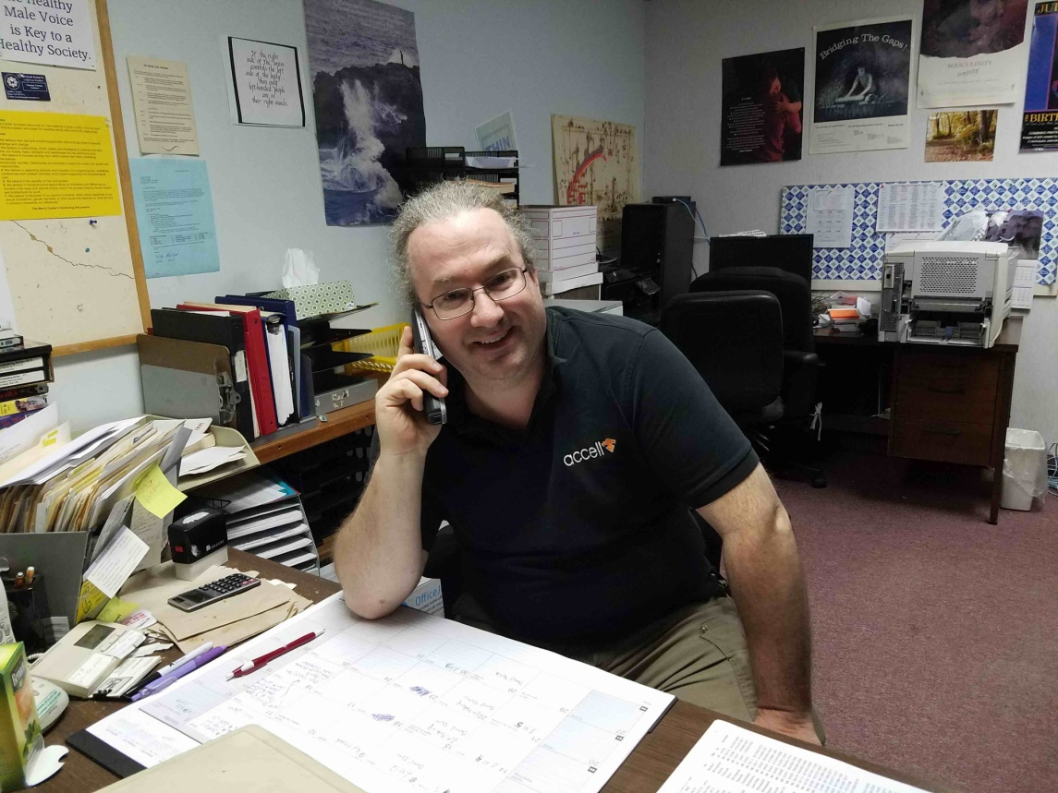
LOCATION & DETAILS
Twin Cities Men's Center
3249 Hennepin Ave. So, Suite 55
Minneapolis, MN 55408 USA
612-822-5892

Slide 3
Our Mission
To provide resources for men seeking to grow in body, mind, and spirit; and from that foundation to advocate for healthier family and community relationships.

Slide 4
What We Offer
Each week TCMC offers opportunities to meet informally in a safe setting to discuss topics of mutual concern.
Sessions are primarily for support; they are not therapy groups
Most groups are drop-in support, no appointment is necessary to attend, and are no set fees; donations are requested.

Slide 5
Our Current Groups, Courses, Programs and Presentations

Slide 6

Anger Management Program

Slide 7
Main Objective
To learn and actively practice new skills, tools, and techniques to understand and manage your anger, feel better about yourself in day-to-day life and, as a result, significantly improve relationships at home and work.

Slide 8
Program Details
One evening per week for 12 consecutive weeks. Each class lasts about two hours.
Space is limited to 15 participants with 2 facilitators per class.
Cost: $275 ($265 for Men Center members)
Retake: $65 for up to 3 years
Start dates are based on availability for details call TCMC at 612-822-5892 or John Hesch at 612-229-3102

Slide 9
What you will learn in this program
To better understand your anger escalation process.
To become clearer about how explosive anger affects you and others around you.
To end threatening and intimidating behavior and to decrease the frequency of emotional and verbal abuse toward others.

Slide 10
And
To accept responsibility for past abusive behavior and to work at identifying and changing controlling attitudes and behaviors that have led to becoming explosive and abusive.
To identify and express more openly and assertively all your feelings
To examine and work on childhood and shame issues that relate to abusive behavior and to better understand how these issues relate to your current abuse of others.

Slide 11
Finally
To learn to experience more control over yourself and your actions and to make clear choices about—and take responsibility for—thoughts, feelings, wants and behaviors in the present.
To learn to identify and deal more effectively with life stressors as they arise.
To begin to actively use group members and others for emotional support and sharing.

Slide 12
This Program is:
For men who believe that their verbal and emotional expression of anger is out of control.
For men who desire to significantly improve their relationships at home and at work.

Slide 13
Comments received from a Court Officer in Alaska about working with the Twin Cities Men’s Center and their Anger Management Program:
Thank you both for your quick responses and the information. I'm impressed with the responsiveness and professionalism of your program there and I only wish that we had the equivalent here in Alaska.
~ Anna Ambrose

Slide 14
Support Groups
A Facilitator will be an individual who volunteers after previous participation in TCMC Support groups
Groups are open to general issues that concern individuals in their personal growth
The sessions are primarily for support; they are not therapy groups.
A donation of $3-9 helps keep TCMC operational.
All groups are men only, except where listed for women in the current newsletter.

Slide 15
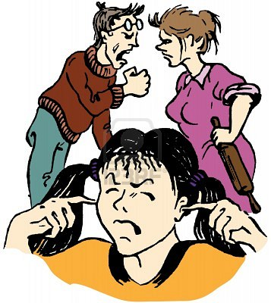
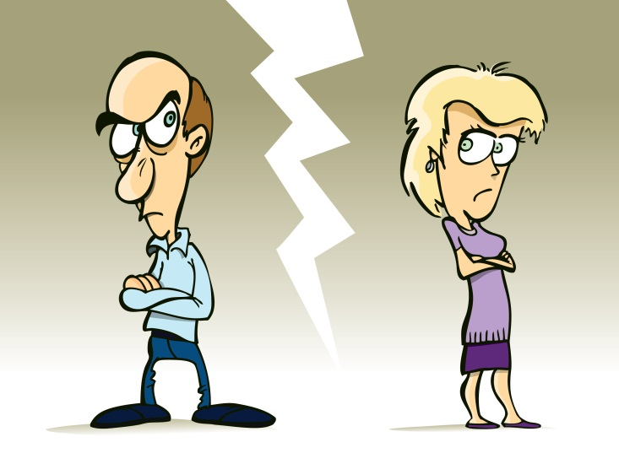
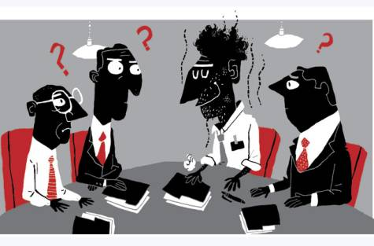
General/Divorce/Uncoupling/Family/Workplace

Slide 16
Group Topics
Men express feelings about separation
Divorce - such as child custody/legal hassles
Breaking up with a lover
General Family Issues
Issues in the Workplace
Men can express what it means to be a man in our culture and other issues in their lives.

Slide 17
Meeting Times and Location
Open Drop In Group
Thursdays, 7:30 - 9:30 pm
Video Chat

Slide 18
Sexual Abuse & Trauma Survivors
Open to both Men and Women
Dealing with the difficult feelings of fear, anger, grief, or embarrassment
Provides a safe environment to share your experiences and learn from others.
Open drop in group for survivors, loved ones, professionals, educators, clergy, law enforcement, students and others interested in the issues
Meets on Thursdays 7:30 -9:30 PM.

Slide 19
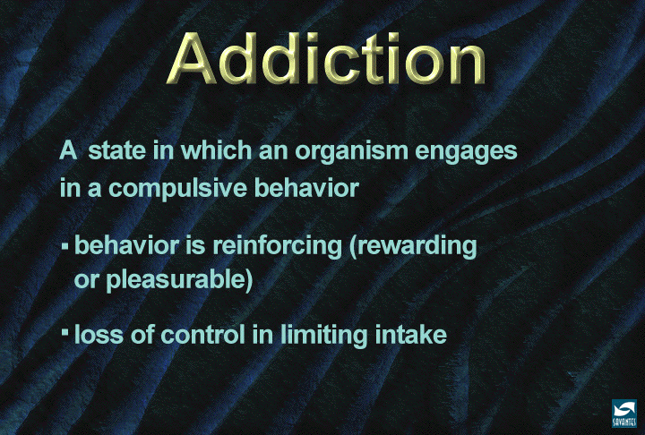
Addiction Busters

Slide 20
Group Topics
Discuss alternative, cognitive approaches that may help you battle your addiction in new and different ways!
Mixed open group for men and women seeking support in dealing with all forms of addictions.
Alternative to the 12 step model
Uses the SMART model of recovery.
Meets Wednesdays at 7:30 – 9:30 PM

Slide 21

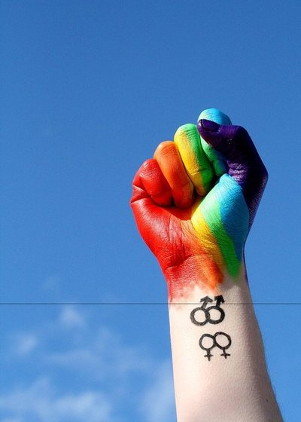


Gay Issues Support Group

Slide 22
Group Topics
Men express feelings about life's challenges and experiences, and what it means to be gay and male (you don't have to be gay to attend.)
This is the Twin Cities longest running gay support group.
Coming out, relationships, friends, family, the workplace.
Wide range from “out” for years to newly out married and still “in the closet”

Slide 23
Meeting Details
Groups range in size from 10 to 35. Larger groups are often split up into smaller groups.
Open walk-in group no fee to attend based on donations at the end of the meeting.
Meets Tuesdays 7:30PM to 9:30PM

Slide 24
Sexually Evolving Male
Open to Men and Transgender Men
If sexuality is at the root of our existence and "change" is the only continuous thing in life. Why would our sexuality, how we identify ourselves, desires, and experiences be any different?
This group is for men who are evolving sexually and question how the evolving intersect with their day to day life.
Group meets on Fridays 7:30 to 9:30PM

Slide 25
Choosing Healthy Sexual Boundaries
This group is a safe, non-confrontational, non-judgmental place to talk with other men about healthy sexual boundaries.
Topics include: Obsessive/Compulsive sexual behavior, sexual addiction, pornography, fantasies, thoughts and behaviors, shame and regret.
Healthy Boundaries welcomes all men who are currently participating in, or who have completed, sex offender treatment.
Meets on Wednesdays 5:30 PM to 7:30 PM

Slide 26
Monthly Support Groups
And
Clinics/Workshops

Slide 27
Monthly Family Law Clinic
First Wednesday of every month. Targeted to the needs of men or women going through or anticipating divorce or dealing with other family law issues, this Clinic gives you an opportunity to discuss your own questions on such topics as:
• Divorce
• Separation
• Paternity
• Property Division
• Custody
• Spousal Maintenance
• Child Support
• Financial Settlements
• Co-habitation
• Your personal issue

Slide 28
Thank You

